Slide 1
Denoising Diffusion Probabilistic Models
Jonathan Ho, Ajay Jain, Pieter Abbeel
모바일시스템공학과
박찬호
Ho, Jonathan, Ajay Jain, and Pieter Abbeel. "Denoising diffusion probabilistic models." Advances in Neural Information Processing Systems 33 (2020): 6840-6851.

Slide 2
Contents
Before Getting Started
Generative Models
Diffusion?
Markov Chain
ELBO, Hierarchical VAE
Diffusion Model
Overview
Diffusion Process
Variational Diffusion
Parameterizing
DDPM
Loss
Architecture
Results
Conclusion

Slide 3
Contents
Before Getting Started
Generative Models
Diffusion?
Markov Chain
ELBO, Hierarchical VAE
Diffusion Model
Overview
Diffusion Process
Variational Diffusion
Parameterizing
DDPM
Loss
Architecture
Results
Conclusion

Slide 4
Before Getting Started
Jonathan Ho, Ajay Jain, Pieter Abbeel
NeurlIPS
2020
Diffusion
Generative Model
Variational Inference, ELBO

Slide 5
Before Getting Started – Main References
Ho, Jonathan, Ajay Jain, and Pieter Abbeel. "Denoising diffusion probabilistic models." Advances in Neural Information Processing Systems 33 (2020): 6840-6851.
Luo, Calvin. "Understanding diffusion models: A unified perspective." arXiv preprint arXiv:2208.11970 (2022).
Sohl-Dickstein, Jascha, et al. "Deep unsupervised learning using nonequilibrium thermodynamics." International Conference on Machine Learning. PMLR, 2015.

Slide 6
Before Getting Started
Generative Models Timeline
2014
2015
2016
2017
2018
2019
2020
2021
2022
VAE
Original GAN
PixelRNN
EBGAN
DDPM
DDIM
StyleGAN
Stable Diffusion
DCGAN
First Diffusion*
First Flow-based**
CycleGAN
DeepFakes
PixelCNN++
SAGAN
Diffusion Models Beat GANs on Image Synthesis
Latent Diffusion Models (Stable Diffusion)
* Jascha Sohl-Dickstein et al. Unsupervised Learning using Nonequilibrium Thermodynamics ** Danilo Jimenez Rezende; Mohamed, Shakir. Variational Inference with Normalizing Flows

Slide 7
Before Getting Started
Generative Models Timeline
2014
2015
2016
2017
2018
2019
2020
2021
2022
VAE
Original GAN
PixelRNN
EBGAN
DDPM
DDIM
StyleGAN
Stable Diffusion
DCGAN
First Diffusion*
First Flow-based**
CycleGAN
DeepFakes
PixelCNN++
SAGAN
Diffusion Models Beat GANs on Image Synthesis
Latent Diffusion Models (Stable Diffusion)
* Jascha Sohl-Dickstein et al. Unsupervised Learning using Nonequilibrium Thermodynamics ** Danilo Jimenez Rezende; Mohamed, Shakir. Variational Inference with Normalizing Flows

Slide 8
Before Getting Started
Generative Models Timeline
2014
2015
2016
2017
2018
2019
2020
2021
2022
VAE
Original GAN
PixelRNN
EBGAN
DDPM
DDIM
StyleGAN
Stable Diffusion
DCGAN
First Diffusion*
First Flow-based**
CycleGAN
DeepFakes
PixelCNN++
SAGAN
Diffusion Models Beat GANs on Image Synthesis
Latent Diffusion Models (Stable Diffusion)
* Jascha Sohl-Dickstein et al. Unsupervised Learning using Nonequilibrium Thermodynamics ** Danilo Jimenez Rezende; Mohamed, Shakir. Variational Inference with Normalizing Flows

Slide 9
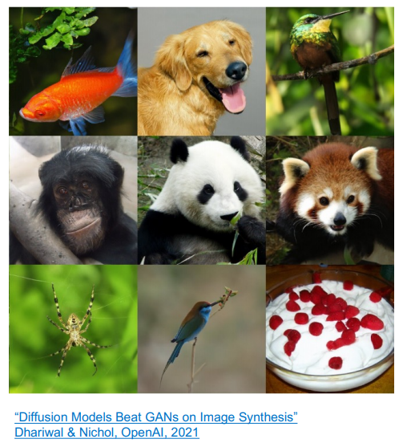
Before Getting Started
Generative Models Timeline
2014
2015
2016
2017
2018
2019
2020
2021
2022
VAE
Original GAN
PixelRNN
EBGAN
DDPM
DDIM
StyleGAN
Stable Diffusion
DCGAN
First Diffusion*
First Flow-based**
CycleGAN
DeepFakes
PixelCNN++
SAGAN
Diffusion Models Beat GANs on Image Synthesis
Latent Diffusion Models (Stable Diffusion)
https://cvpr2022-tutorial-diffusion-models.github.io/

Slide 10
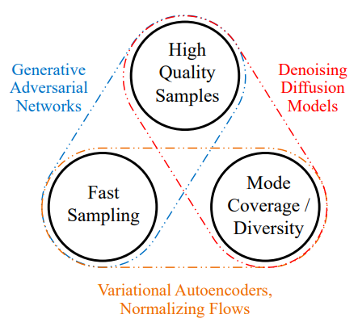
Before Getting Started – Impacts of Diffusion
Text-to-Image Generators
DALL-E : 2 (not DALL-E : 1)
Imagen
Stable diffusion
Xiao, Zhisheng, Karsten Kreis, and Arash Vahdat. "Tackling the generative learning trilemma with denoising diffusion gans." arXiv preprint arXiv:2112.07804 (2021).

Slide 11
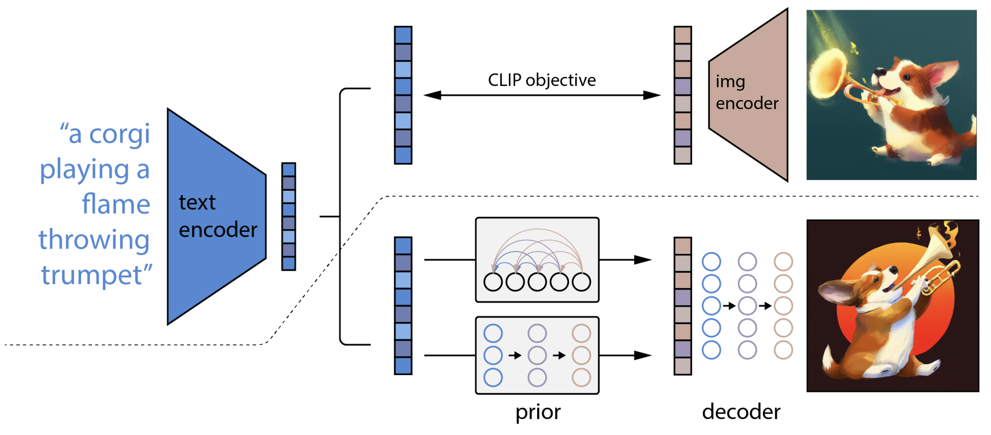
Before Getting Started – Impacts of Diffusion
Text-to-Image Generators
DALL-E : 2 (not DALL-E : 1)
Imagen
Stable diffusion
Diffusion
Leivada, Evelina, Elliot Murphy, and Gary Marcus. "DALL-E 2 Fails to Reliably Capture Common Syntactic Processes." arXiv preprint arXiv:2210.12889 (2022).

Slide 12
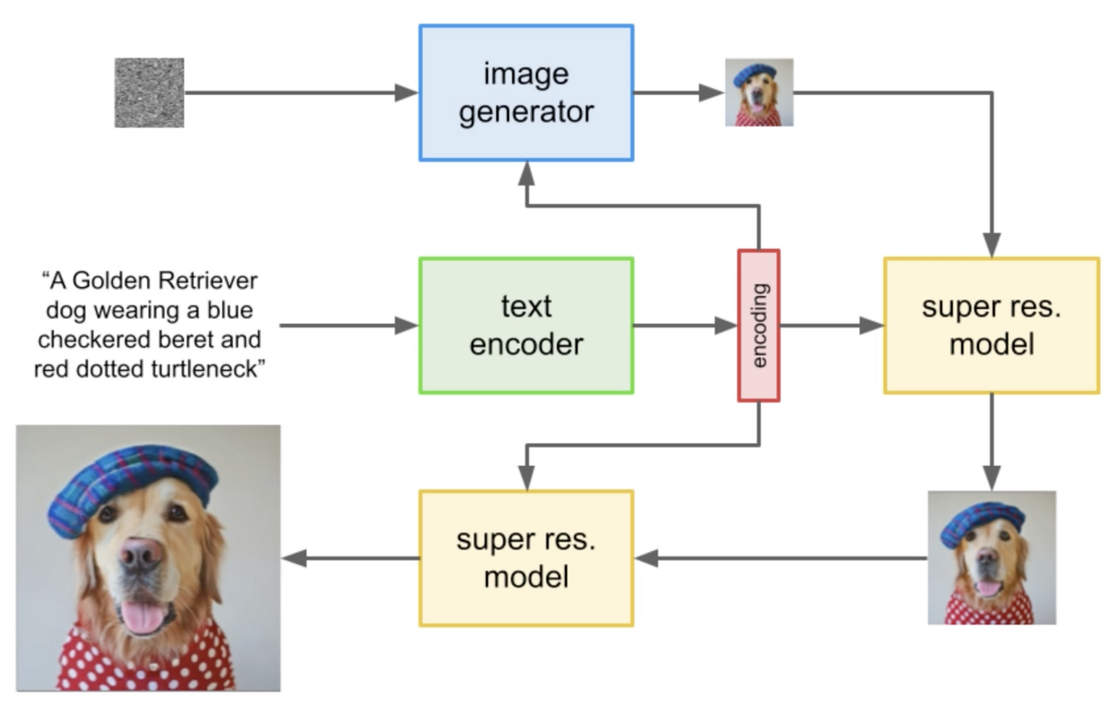
Before Getting Started – Impacts of Diffusion
Text-to-Image Generators
DALL-E : 2 (not DALL-E : 1)
Imagen
Stable diffusion
Saharia, Chitwan, et al. "Photorealistic Text-to-Image Diffusion Models with Deep Language Understanding." arXiv preprint arXiv:2205.11487 (2022).

Slide 13
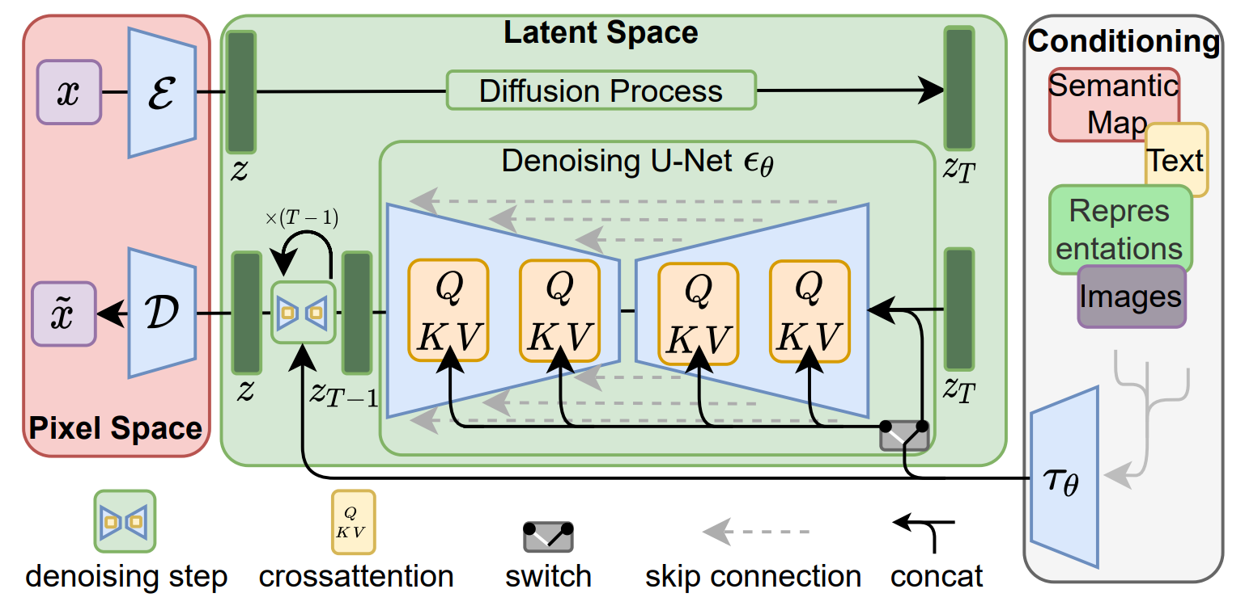
Before Getting Started – Impacts of Diffusion
Text-to-Image Generators
DALL-E : 2 (not DALL-E : 1)
Imagen
Stable diffusion
Rombach, Robin, et al. "High-resolution image synthesis with latent diffusion models." Proceedings of the IEEE/CVF Conference on Computer Vision and Pattern Recognition. 2022.

Slide 14


Before Getting Started – Impacts of Diffusion
Text-to-Image Generators
DALL-E : 2 (not DALL-E : 1)
Imagen
Stable diffusion

Slide 15
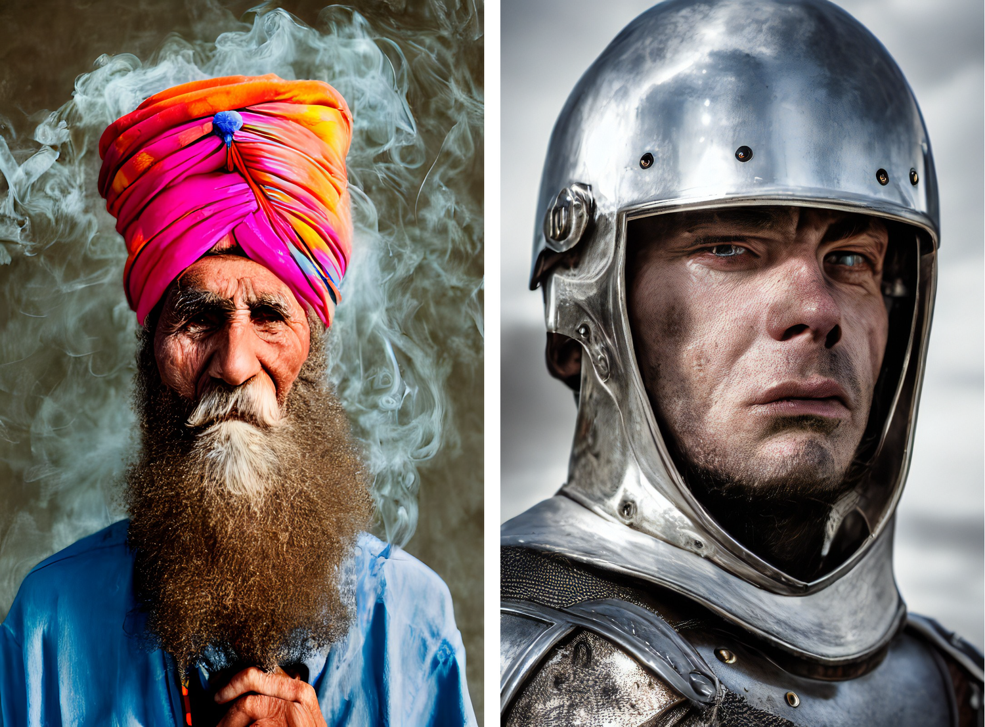
Before Getting Started – Impacts of Diffusion
Text-to-Image Generators
DALL-E : 2 (not DALL-E : 1)
Imagen
Stable diffusion

Slide 16
Contents
Before Getting Started
Generative Models
Diffusion?
Markov Chain
ELBO, Hierarchical VAE
Diffusion Model
Overview
Diffusion Process
Variational Diffusion
Parameterizing
DDPM
Loss
Architecture
Results
Conclusion

Slide 17
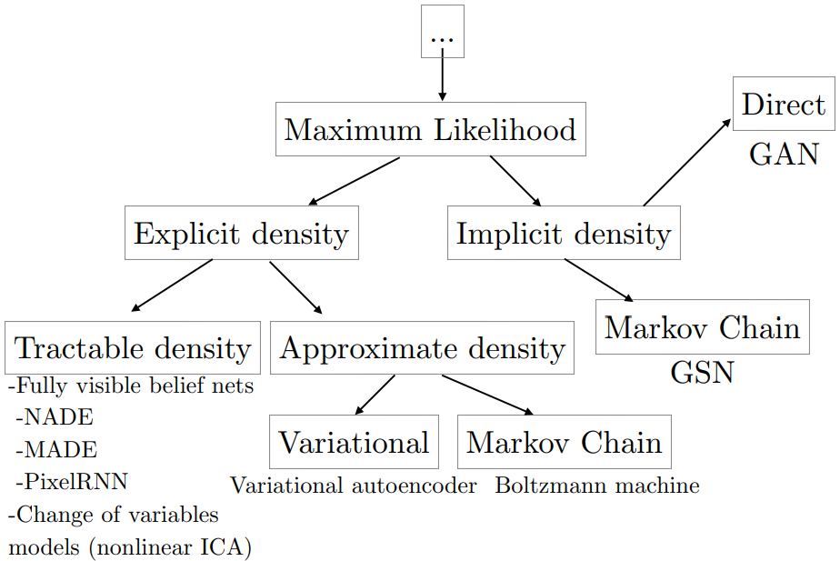
Generative Models
Generative Model Taxonomy

Slide 18
Generative Models
Generative Model Taxonomy
Diffusion Models

Slide 19
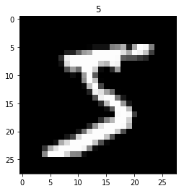
Generative Models
Generative Models
Noise → Output
Distribution of Output
Latent Variable
Maximum Likelihood Estimation

Slide 20

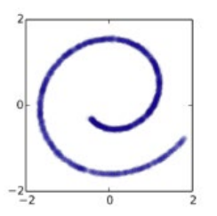
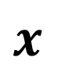
Generative Models
Representative
Generative Models
$$x$$
https://lilianweng.github.io/posts/2021-07-11-diffusion-models/

Slide 21
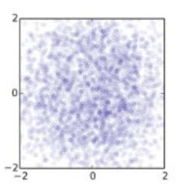
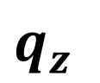
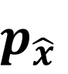
Generative Models - GAN
$$q_{z}$$
$$p_{\hat{x}}$$
Generator
https://www.slideshare.net/HyeongminLee3/pr409-denoising-diffusion-probabilistic-models

Slide 22
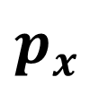
Generative Models - GAN
$$p_{x}$$
Discriminator
Real?
Fake?
$$q_{z}$$
$$p_{\hat{x}}$$
Generator
https://www.slideshare.net/HyeongminLee3/pr409-denoising-diffusion-probabilistic-models

Slide 23
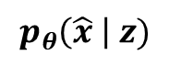
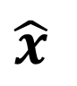
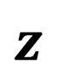
Generative Models - VAE
$$p_{θ}\left(\hat{x} \right| z)$$
Decoder
$$z$$
$$\hat{x}$$
https://www.slideshare.net/HyeongminLee3/pr409-denoising-diffusion-probabilistic-models

Slide 24
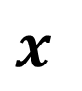
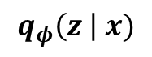
Generative Models - VAE
$$q_{φ}\left(z \right| x)$$
$$p_{θ}\left(\hat{x} \right| z)$$
Encoder
Decoder
$$x$$
$$z$$
$$\hat{x}$$
https://www.slideshare.net/HyeongminLee3/pr409-denoising-diffusion-probabilistic-models

Slide 25
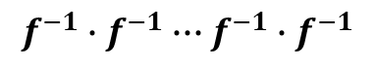
Generative Models – Normalizing Flow
$$f^{−1}∙f^{−1}∙∙∙f^{−1}∙f^{−1}$$
$$z$$
$$\hat{x}$$
https://www.slideshare.net/HyeongminLee3/pr409-denoising-diffusion-probabilistic-models

Slide 26
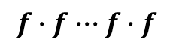
Generative Models – Normalizing Flow
$$f∙f∙∙∙f∙f$$
$$f^{−1}∙f^{−1}∙∙∙f^{−1}∙f^{−1}$$
$$x$$
$$z$$
$$\hat{x}$$
https://www.slideshare.net/HyeongminLee3/pr409-denoising-diffusion-probabilistic-models

Slide 27
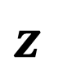
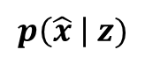
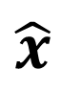
Generative Models – Diffusion Models
$$p\left(\hat{x} \right| z)$$
$$z$$
$$\hat{x}$$
https://www.slideshare.net/HyeongminLee3/pr409-denoising-diffusion-probabilistic-models

Slide 28
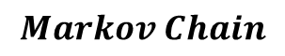
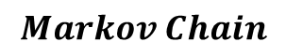
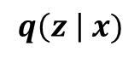
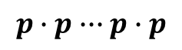
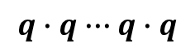
Generative Models – Diffusion Models
$$q\left(z \right| x)$$
$$p\left(\hat{x} \right| z)$$
$$q∙q∙∙∙q∙q$$
$$p∙p∙∙∙p∙p$$
$$Markov Chain$$
$$Markov Chain$$
$$x$$
$$z$$
$$\hat{x}$$
https://www.slideshare.net/HyeongminLee3/pr409-denoising-diffusion-probabilistic-models

Slide 29
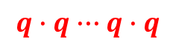
Generative Models – Diffusion Models
Fixed!
$$q∙q∙∙∙q∙q$$
$$p∙p∙∙∙p∙p$$
$$x$$
$$z$$
$$\hat{x}$$
https://www.slideshare.net/HyeongminLee3/pr409-denoising-diffusion-probabilistic-models

Slide 30
Generative Models – Diffusion Models
Fixed!
$$q∙q∙∙∙q∙q$$
$$p∙p∙∙∙p∙p$$
$$x$$
$$z$$
$$\hat{x}$$
Diffusion
Reverse
(Generation)
https://www.slideshare.net/HyeongminLee3/pr409-denoising-diffusion-probabilistic-models

Slide 31
Contents
Before Getting Started
Generative Models
Diffusion?
Markov Chain
ELBO, Hierarchical VAE
Diffusion Model
Overview
Diffusion Process
Variational Diffusion
Parameterizing
DDPM
Loss
Architecture
Results
Conclusion

Slide 32
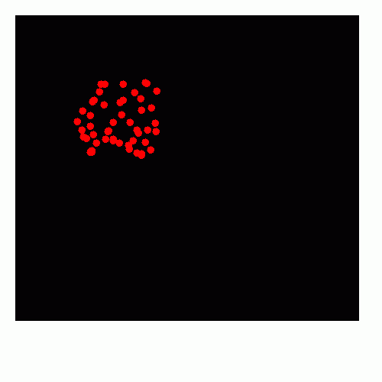
Diffusion
Thermodynamic
From a region of higher concentration to a region of lower concentration
Original distribution collapsing while diffusion
https://en.wikipedia.org/wiki/Diffusion, https://cronodon.com/BioTech/Diffusion.html

Slide 33
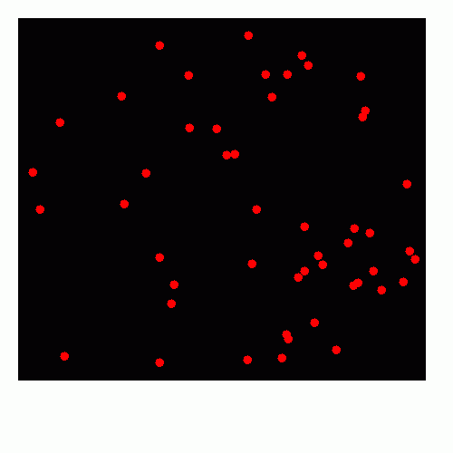
Diffusion
Thermodynamic
From a region of higher concentration to a region of lower concentration
Original distribution collapsing while diffusion
Reverse Process?
https://en.wikipedia.org/wiki/Diffusion, https://cronodon.com/BioTech/Diffusion.html

Slide 34
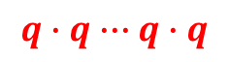

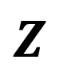
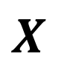
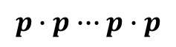
Diffusion
Fixed!
$$q∙q∙∙∙q∙q$$
$$p∙p∙∙∙p∙p$$
$$X$$
$$Z$$
$$\hat{X}$$
Diffusion
Reverse
(Generation)
https://www.slideshare.net/HyeongminLee3/pr409-denoising-diffusion-probabilistic-models, https://cronodon.com/BioTech/Diffusion.html

Slide 35
Diffusion
Fixed!
$$q∙q∙∙∙q∙q$$
$$p∙p∙∙∙p∙p$$
$$X$$
$$Z$$
$$\hat{X}$$
Diffusion
Reverse
(Generation)
https://www.slideshare.net/HyeongminLee3/pr409-denoising-diffusion-probabilistic-models, https://cronodon.com/BioTech/Diffusion.html

Slide 36
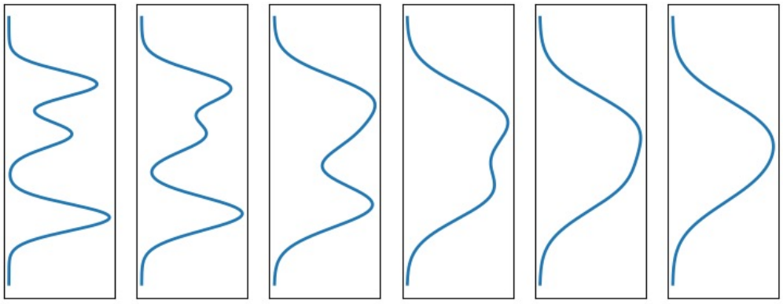
Diffusion
Fixed!
$$q∙q∙∙∙q∙q$$
$$p∙p∙∙∙p∙p$$
$$X$$
$$Z$$
$$\hat{X}$$
Diffusion
Reverse
(Generation)
https://www.slideshare.net/HyeongminLee3/pr409-denoising-diffusion-probabilistic-models, https://cronodon.com/BioTech/Diffusion.html, https://cvpr2022-tutorial-diffusion-models.github.io/

Slide 37
Diffusion
Fixed!
$$q∙q∙∙∙q∙q$$
$$p∙p∙∙∙p∙p$$
$$X$$
$$Z$$
$$\hat{X}$$
Diffusion
How?
Reverse
(Generation)
https://www.slideshare.net/HyeongminLee3/pr409-denoising-diffusion-probabilistic-models, https://cronodon.com/BioTech/Diffusion.html, https://cvpr2022-tutorial-diffusion-models.github.io/

Slide 38
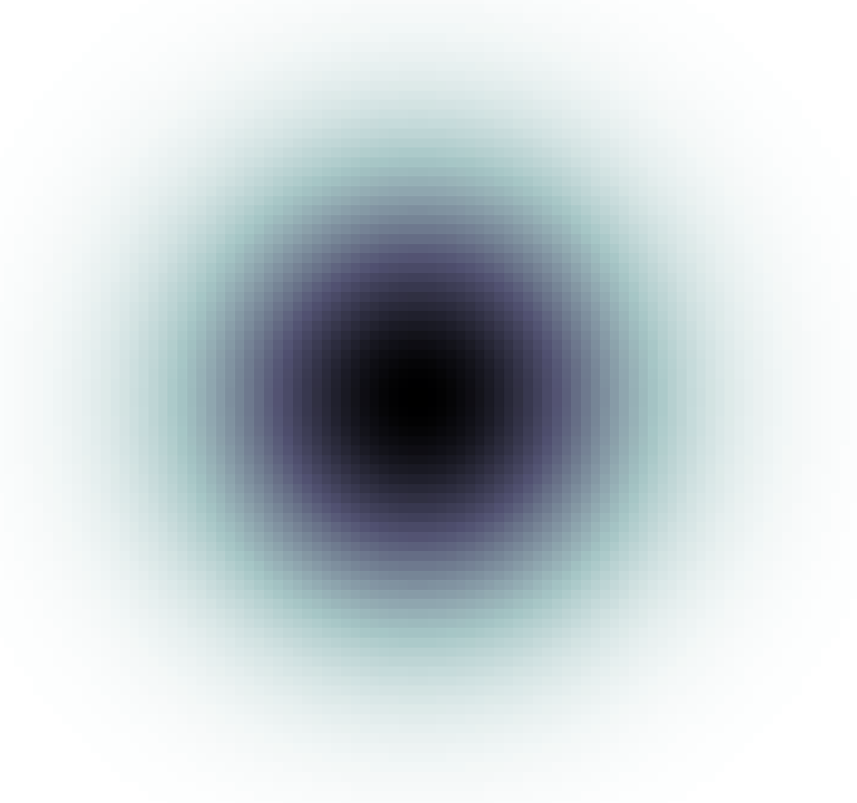
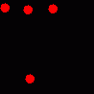
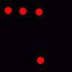
Diffusion
Diffusion
Gaussian!
https://datascienceschool.net/03%20machine%20learning/03.02.02%20%EC%9D%B4%EB%AF%B8%EC%A7%80%20%ED%95%84%ED%84%B0%EB%A7%81.html https://cronodon.com/BioTech/Diffusion.html, https://cvpr2022-tutorial-diffusion-models.github.io/

Slide 39
Diffusion
Diffusion
Gaussian!
Reverse
Feller, W. On the theory of stochastic processes, with particular reference to applications. In Proceedings of the [First] Berkeley Symposium on Mathematical Statistics and Probability. The Regents of the University of California, 1949.

Slide 40


Diffusion
Diffusion
$$∙∙∙$$
$$∙∙∙$$
Gaussian!
Reverse

Slide 41
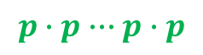
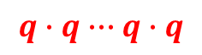
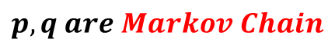
Diffusion
Diffusion
$$q∙q∙∙∙q∙q$$
$$∙∙∙$$
$$∙∙∙$$
$$p∙p∙∙∙p∙p$$
Reverse
$$p, q are Markov Chain$$

Slide 42
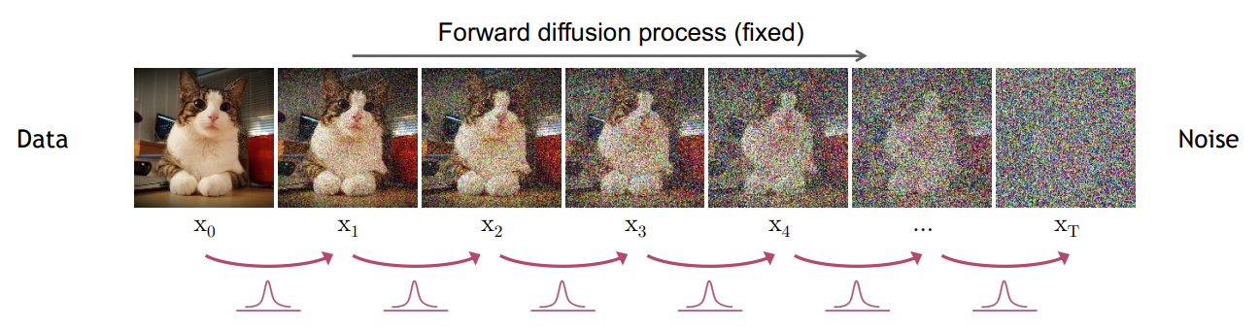
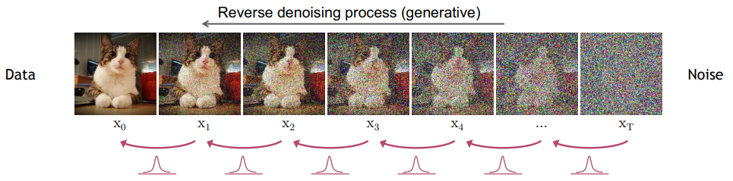
Diffusion

Slide 43
Contents
Before Getting Started
Generative Models
Diffusion?
Markov Chain
ELBO, Hierarchical VAE
Diffusion Model
Overview
Diffusion Process
Variational Diffusion
Parameterizing
DDPM
Loss
Architecture
Results
Conclusion

Slide 44
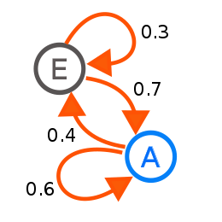
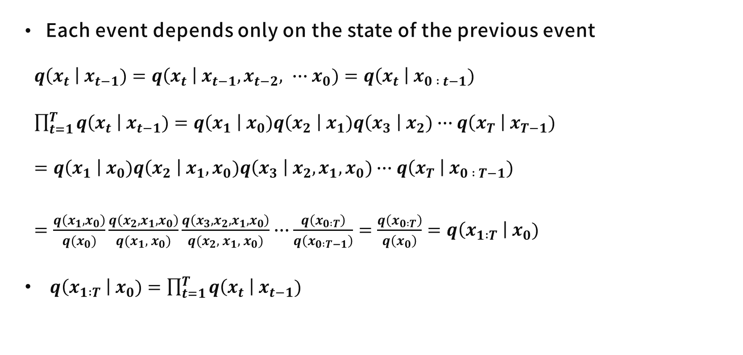
Markov Chain
Each event depends only on the state of the previous event
$q\left(x_{t} \right| x_{t−1})=q\left(x_{t} \right| x_{t−1}, x_{t−2}, ∙∙∙x_{0})=q\left(x_{t} \right| x_{0 : t−1})$
$\prod_{t=1}^{T}{q\left(x_{t} \right| x_{t−1})=q\left(x_{1} \right| x_{0})q\left(x_{2} \right| x_{1})q\left(x_{3} \right| x_{2})∙∙∙q\left(x_{T} \right| x_{T−1})}$
$=q\left(x_{1} \right| x_{0})q\left(x_{2} \right| x_{1}, x_{0})q\left(x_{3} \right| x_{2},x_{1}, x_{0})∙∙∙q\left(x_{T} \right| x_{0 : T−1})$
$=\frac{q\left(x_{1}, x_{0}\right)}{q(x_{0})}\frac{q\left(x_{2}, x_{1}, x_{0}\right)}{q(x_{1}, x_{0})}\frac{q\left({x_{3},x}_{2}, x_{1}, x_{0}\right)}{q(x_{2}, x_{1}, x_{0})}∙∙∙\frac{q\left(x_{0 :T}\right)}{q\left(x_{0 :T−1}\right)}=\frac{q\left(x_{0 :T}\right)}{q\left(x_{0}\right)}=q\left(x_{1 :T} \right| x_{0})$
$q\left(x_{1 :T} \right| x_{0})=\prod_{t=1}^{T}{q\left(x_{t} \right| x_{t−1})}$
https://youtu.be/uFoGaIVHfoE

Slide 45
Contents
Before Getting Started
Generative Models
Diffusion?
Markov Chain
ELBO, Hierarchical VAE
Diffusion Model
Overview
Diffusion Process
Variational Diffusion
Parameterizing
DDPM
Loss
Architecture
Results
Conclusion

Slide 46
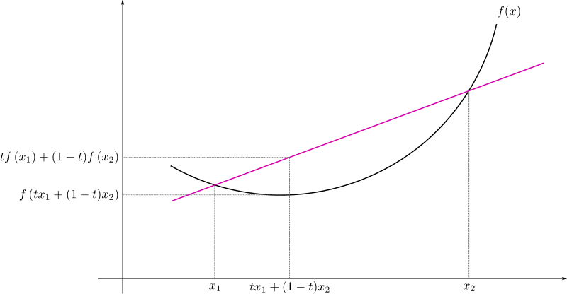
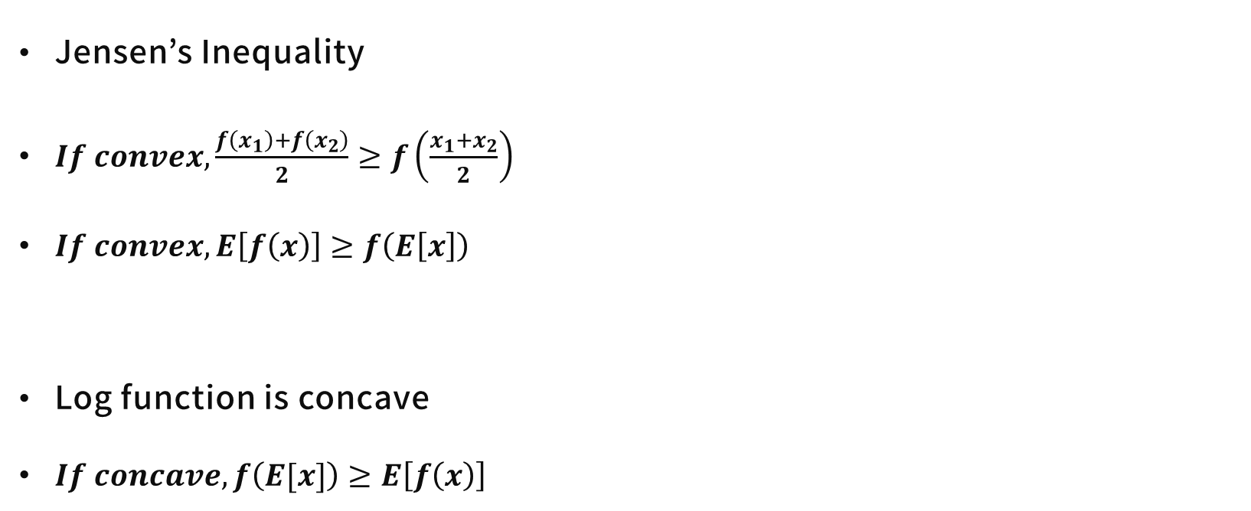
ELBO
Jensen’s Inequality
$If convex,\frac{f\left(x_{1}\right)+f\left(x_{2}\right)}{2}≥f\left(\frac{x_{1}+x_{2}}{2}\right)$
$If convex,E\left[f\left(x\right)\right]≥f\left(E\left[x\right]\right)$
Log function is concave
$If concave, f\left(E[x]\right)≥E\left[f\left(x\right)\right]$

Slide 47
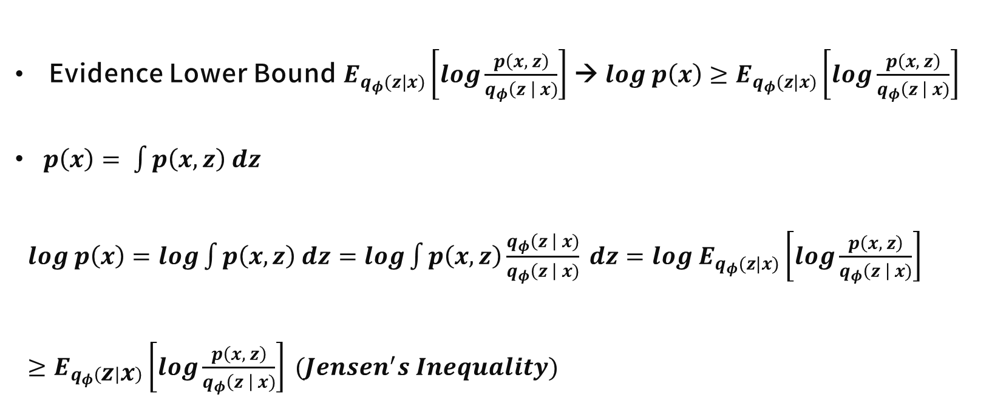
ELBO
Evidence Lower Bound $E_{q_{φ}(z|x)}\left[log\frac{p\left(x, z\right)}{q_{φ}\left(z \right| x)}\right]$ → $log p\left(x\right)≥E_{q_{φ}(z|x)}\left[log\frac{p\left(x, z\right)}{q_{φ}\left(z \right| x)}\right]$
$p\left(x\right)= \int{p\left(x,z\right) dz}$
$log p\left(x\right)=log\int{p\left(x,z\right) dz}=log\int{p\left(x,z\right)\frac{q_{φ}\left(z \right| x)}{q_{φ}\left(z \right| x)} dz}=log E_{q_{φ}(z|x)}\left[log\frac{p\left(x, z\right)}{q_{φ}\left(z \right| x)}\right]$
$≥E_{q_{φ}\left(z | x\right)}\left[log\frac{p\left(x, z\right)}{q_{φ}\left(z \right| x)}\right] (Jensen^{′}s Inequality)$

Slide 48


ELBO
Evidence Lower Bound $E_{q_{φ}(z|x)}\left[log\frac{p\left(x, z\right)}{q_{φ}\left(z \right| x)}\right]$ → $log p\left(x\right)≥E_{q_{φ}(z|x)}\left[log\frac{p\left(x, z\right)}{q_{φ}\left(z \right| x)}\right]$
$p\left(x\right)=\frac{p(x , z)}{p\left(z \right| x)}$
Same with VAE

Slide 49


VAE
Loss term of VAE
$E_{q_{φ}(z|x)}\left[log\frac{p\left(x, z\right)}{q_{φ}\left(z\right|x)}\right]=E_{z}\left[log\frac{p_{θ}\left(x\right| z) p(z)}{q_{θ}(z|x)}\right]$
$=E_{q_{φ}(z|x)}\left[log p_{θ}(x|z)\right]+E_{q_{φ}(z|x)}\left[log\frac{p(z)}{q_{φ}(z|x)}\right]$
$=E_{q_{φ}(z|x)}\left[log p_{θ}(x|z)\right] −D_{KL}(q_{φ}\left(z | x\right) || p(z))$
Reconstruction Term
Prior Matching Term

Slide 50


Hierarchical VAE
Multiple hierarchies over latent variables
HVAE of T level hierarchy
T
$$∙∙∙$$
$$∙∙∙$$
T

Slide 51

Markovian HVAE
Encoder and decoder is Markov Chain
Markovian HVAE
Luo, Calvin. "Understanding diffusion models: A unified perspective." arXiv preprint arXiv:2208.11970 (2022).

Slide 52




Markovian HVAE – Maximizing ELBO
$$Markov Chain → q\left(x_{1 :T} \right| x_{0})=\prod_{t=1}^{T}{q\left(x_{t} \right| x_{t−1})}$$
Luo, Calvin. "Understanding diffusion models: A unified perspective." arXiv preprint arXiv:2208.11970 (2022).

Slide 53
Contents
Before Getting Started
Generative Models
Diffusion?
Markov Chain
ELBO, Hierarchical VAE
Diffusion Model
Overview
Diffusion Process
Variational Diffusion
Parameterizing
DDPM
Loss
Architecture
Results
Conclusion

Slide 54
Diffusion Model
By Markovian HVAE, Variational Diffusion Model can be made
Restrictions of Variational Diffusion Model
Latent dimension is equal to the data dimension
Latent Encoder is pre-defined as Gaussian
Gaussian parameters of latent encoders vary over time
To make final latent a standard Gaussian
Luo, Calvin. "Understanding diffusion models: A unified perspective." arXiv preprint arXiv:2208.11970 (2022).

Slide 55

Diffusion Model
Luo, Calvin. "Understanding diffusion models: A unified perspective." arXiv preprint arXiv:2208.11970 (2022).

Slide 56


Diffusion Model - Forward
$β_{t}$ is controllable parameter (scheduling in DDPM)
Slightly adding noise, moving to standard Gaussian
https://cvpr2022-tutorial-diffusion-models.github.io/

Slide 57


Diffusion Model - Backward
https://cvpr2022-tutorial-diffusion-models.github.io/, https://youtu.be/_JQSMhqXw-4

Slide 58

Diffusion Model – Diffusion Process
VDM also maximizes ELBO → objective function
ELBO
Luo, Calvin. "Understanding diffusion models: A unified perspective." arXiv preprint arXiv:2208.11970 (2022).

Slide 59


Diffusion Model – Diffusion Process
By Bayes rule
Luo, Calvin. "Understanding diffusion models: A unified perspective." arXiv preprint arXiv:2208.11970 (2022).

Slide 60

Diffusion Model – Diffusion Process
Luo, Calvin. "Understanding diffusion models: A unified perspective." arXiv preprint arXiv:2208.11970 (2022).

Slide 61
Diffusion Model – Diffusion Process
Reconstuction Term → same with VAE (Monte Carlo)
Prior-matching term → No trainable parameter, about zero by assumption
Gaussian output
Denoising Matching Term → Distribution of Noiser (q) and Denoiser(p) match (by KL Divergence)
Luo, Calvin. "Understanding diffusion models: A unified perspective." arXiv preprint arXiv:2208.11970 (2022).

Slide 62


Diffusion Model – Parameterization (DDPM)
Luo, Calvin. "Understanding diffusion models: A unified perspective." arXiv preprint arXiv:2208.11970 (2022).

Slide 63
Contents
Before Getting Started
Generative Models
Diffusion?
Markov Chain
ELBO, Hierarchical VAE
Diffusion Model
Overview
Diffusion Process
Variational Diffusion
Parameterizing
DDPM
Loss
Architecture
Results
Conclusion

Slide 64


DDPM - Loss
Simple loss
Remove prior matching term
Not training parameter $β_{t}$
Linear Noise Scheduling $β_{t}=[10^{−4} \sim 0.02]$
Latent variable is standard Gaussian
https://youtu.be/_JQSMhqXw-4

Slide 65


DDPM - Loss
Modifying denoising matching term
Mean & Variance function are trainable before DDPM
Only train mean function, variance as time dependent constatnt
$μ_{θ}\left(x_{t}, t\right) → μ_{θ}\left(x_{t},t\right) Σ_{θ}\left(x_{t}, t\right) → σ_{t}^{2}∙I=\tilde{β_{t}}∙I$
$σ_{t}^{2}=\tilde{β_{t}}=\frac{1−\overline{a_{t−1}}}{1−\overline{a_{t}}}β_{t} (\overline{a_{t}} ≔ \prod_{s=1}^{t}{α_{s}}, α_{t}=1−β_{t})$
https://youtu.be/_JQSMhqXw-4

Slide 66

DDPM - Loss
Only train mean function, variance as time dependent constatnt
$μ_{θ}\left(x_{t}, t\right) → μ_{θ}\left(x_{t},t\right) Σ_{θ}\left(x_{t}, t\right) → σ_{t}^{2}∙I=\tilde{β_{t}}∙I$
$σ_{t}^{2}=\tilde{β_{t}}=\frac{1−\overline{α_{t−1}}}{1−\overline{α_{t}}}β_{t} \left(\overline{a_{t}} ≔ \prod_{s=1}^{t}{α_{s}}, α_{t}=1−β_{t}\right)$
$x_{t}\left(x_{0}, ε\right)=\sqrt{{\overline{α}}_{t}}x_{0}+\sqrt{1 −{\overline{α}}_{t}}ε for ε \sim 𝓝\left(0, 1\right)$
$∵q\left(x_{t} \right| x_{t−1}) ≔𝓝\left(x_{t−1};\sqrt{1−β_{t}} x_{t−1}, β_{t}∙I\right), x_{t}=\sqrt{1−β_{t}}x_{t−1}+\sqrt{β_{t}} ε_{t−1}$
$E_{x_{0}, ε}\left[\frac{β_{t}^{2}}{2σ_{t}^{2}α_{t}(1−{\overline{α}}_{t})} {\left|ε −ε_{θ}\left(\sqrt{\overline{α_{t}}}x_{0}+\sqrt{1−\overline{α_{t}}}ε, t\right)\right|}^{2}\right]$
https://youtu.be/_JQSMhqXw-4

Slide 67

DDPM - Loss
$E_{x_{0}, ε}\left[\frac{β_{t}^{2}}{2σ_{t}^{2}α_{t}(1−{\overline{α}}_{t})} {\left|ε −ε_{θ}\left(\sqrt{\overline{α_{t}}}x_{0}+\sqrt{1−\overline{α_{t}}}ε, t\right)\right|}^{2}\right]$
$L_{simple}= E_{x_{0}, ε}\left[ {\left|ε −ε_{θ}\left(\sqrt{\overline{α_{t}}}x_{0}+\sqrt{1−\overline{α_{t}}}ε, t\right)\right|}^{2}\right]$

Slide 68

DDPM - Architecture
Implement using U-Net
https://cvpr2022-tutorial-diffusion-models.github.io/

Slide 69

DDPM - Result

Slide 70


DDPM - Result
(1)
(2)
(3)
(4)

Slide 71
Conclusion
Diffusion Model
DDPM → simple loss, easier training, high performance
Additional
DDIM → Eliminate Markov Chain
Score-based Model
Classifier Guidance
Latent diffusion

Slide 72
Thank
You
감사합니다.

